Slide 1

Presentation of the Kabbalah
Dorian TERBAH - 3IFA
Page 1 / 5

Slide 2
Definition of the Kabbalah
Kabbalah significates « reception », « tradition » and « correspondence »
Esoteric method, discipline and school of thought in jewish mysticism
Types of Kabbalah
  Christian Kabbalah
  Hermetic Qabalah
  Jewish Kabbalah
Ein Sof (Ein for nothing, Sof for limitation)
Page 2 / 5

Slide 3

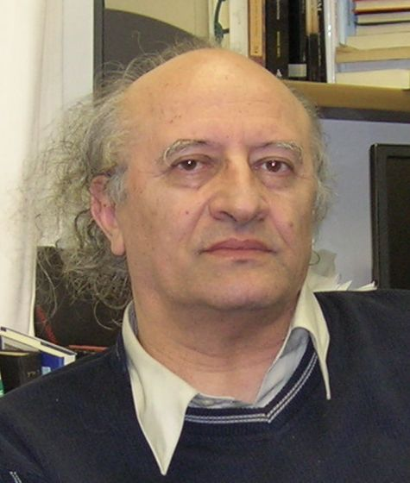
Origins of the Kabbalah
The origins are pretty fuzzy
Author of the Book of the Raziel Angel → period of Eden
Origins during the period of the prophet Elie
Charles Mopsik
French thinker/searcher
Moshé Idel
Israli historian/philisopher
Page 3 / 5

Slide 4
Advantages of the Kabbalah for practitioners
Bring spiritually closer the man to God
Existential questions
Give the exact keys and tools to have a durable fullness
Get inner peace
Page 4 / 5

Slide 5
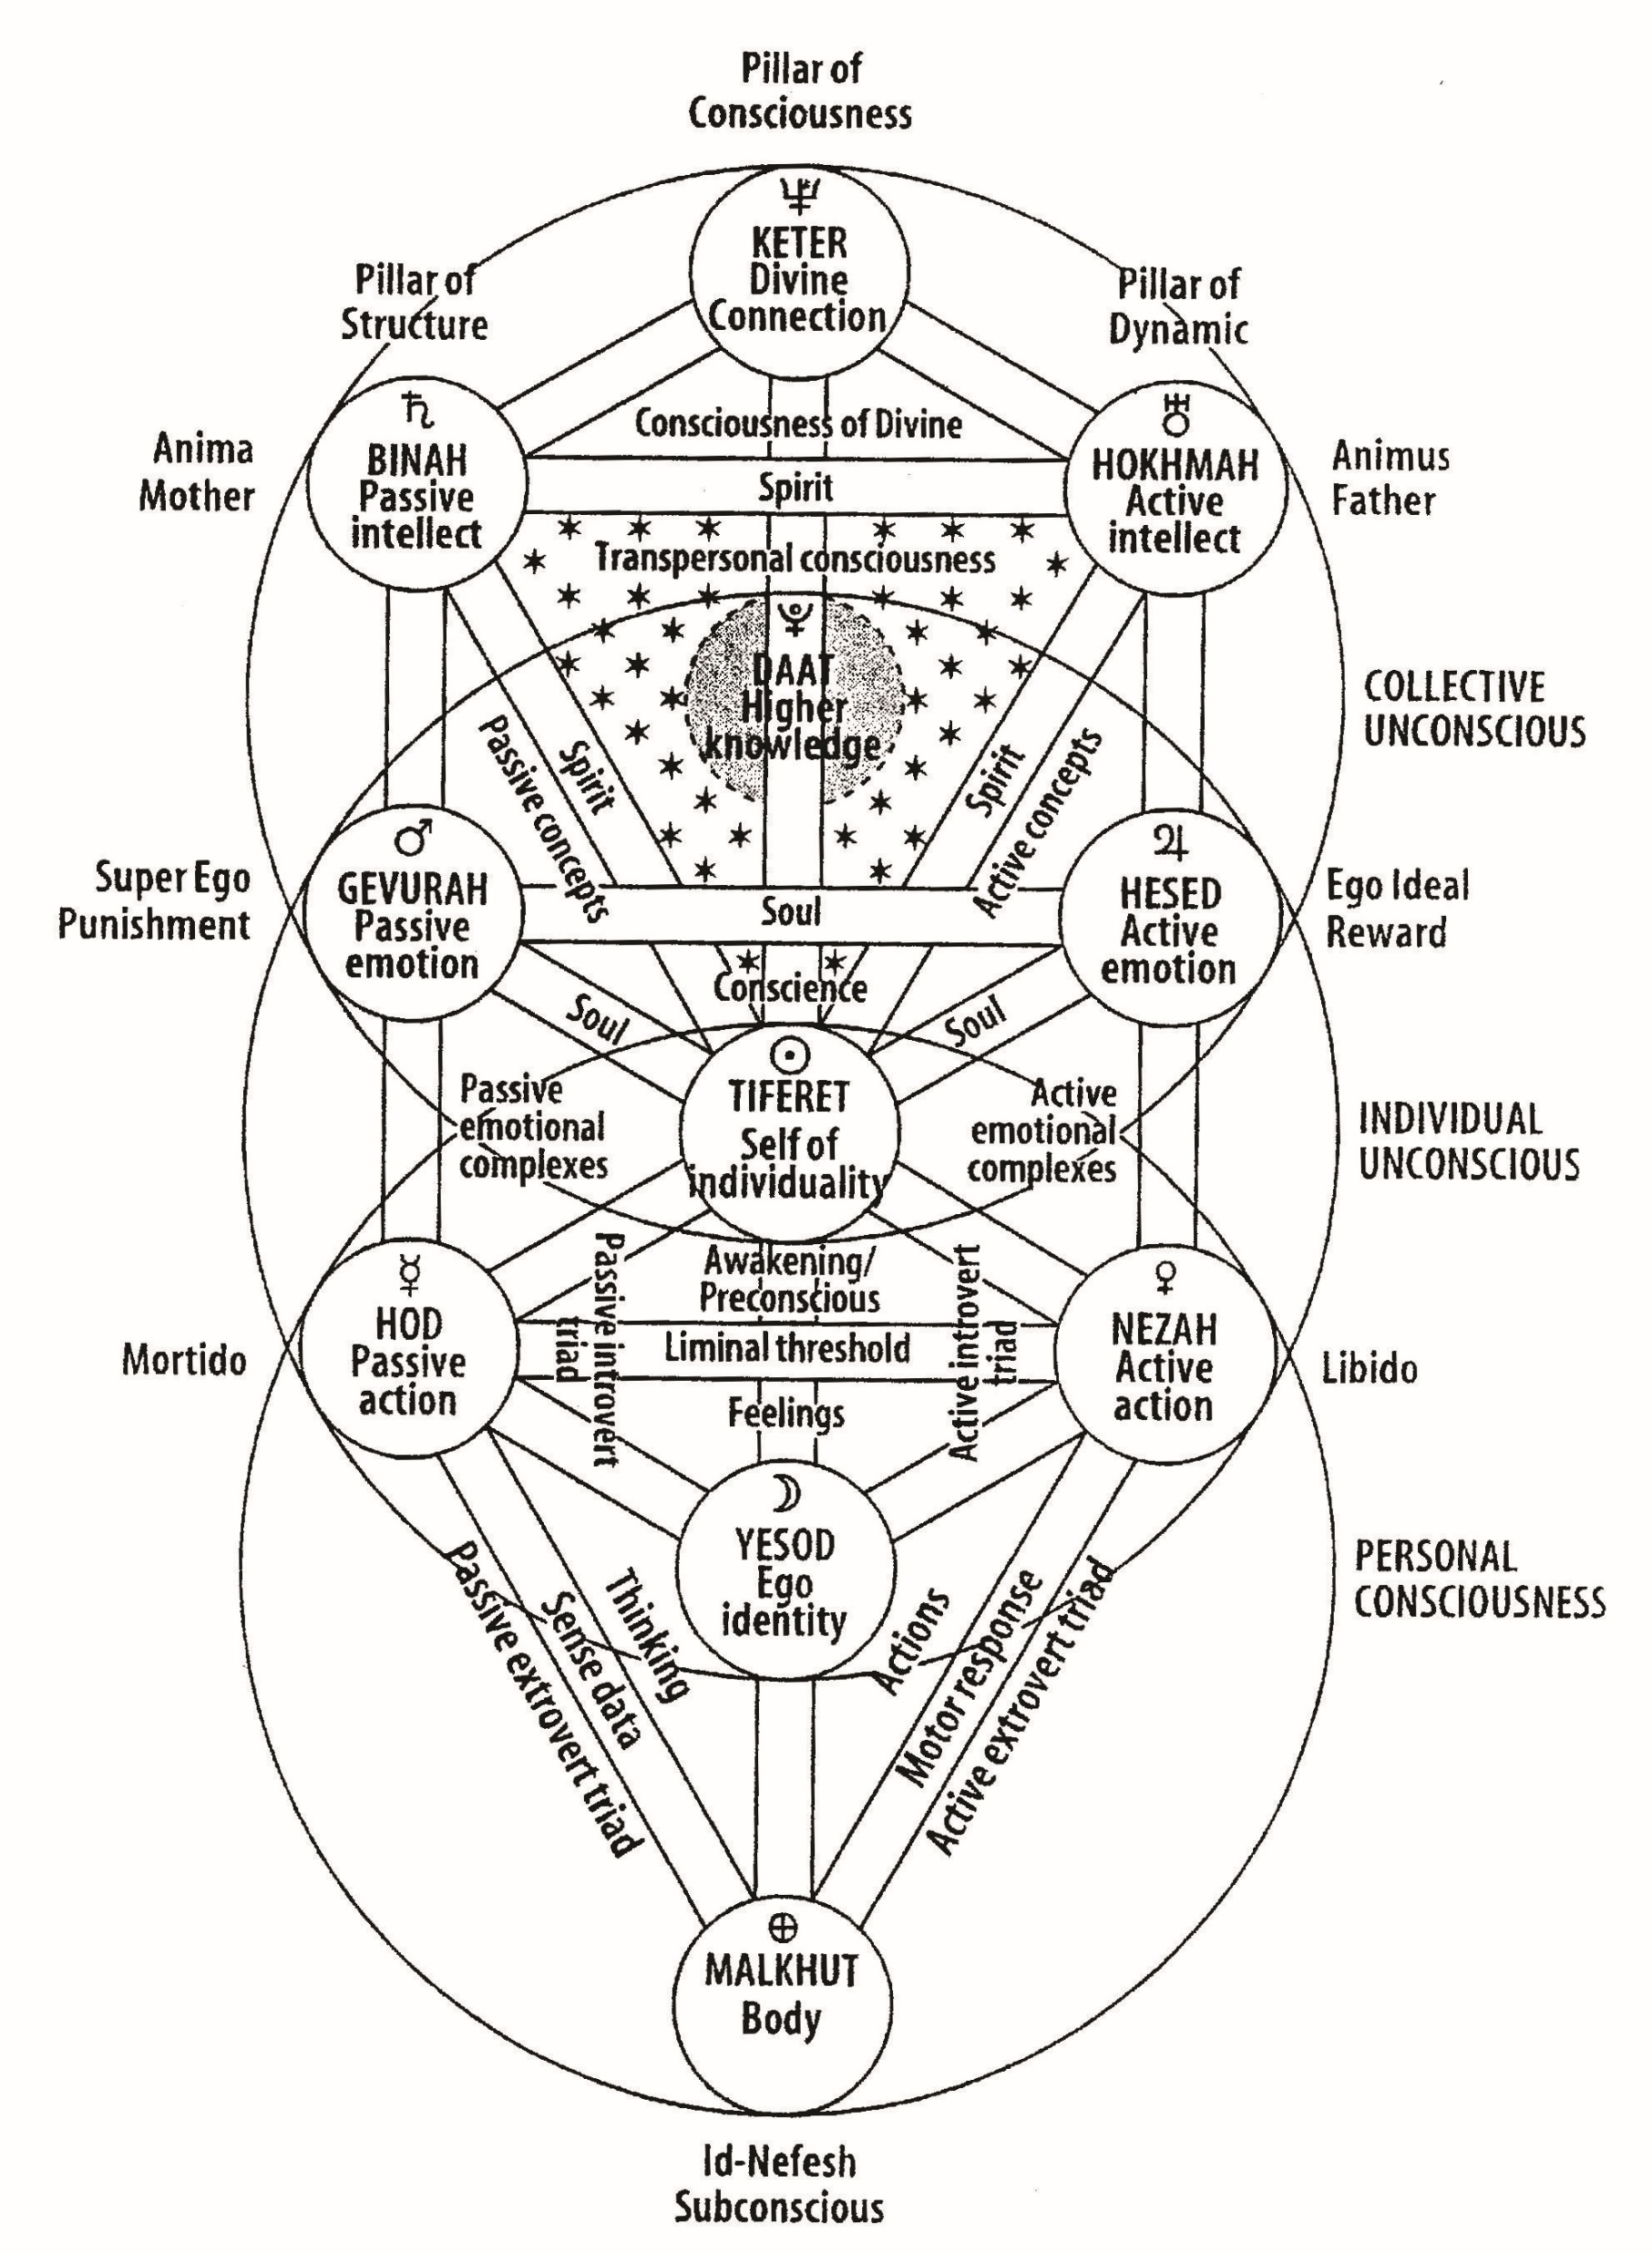
The Tree of Life
Represents the Univers’ laws
Composed of :
  10 Sefirots
  4 worlds
  22 paths
Page 5 / 5

